Slide 1
IMAGE CLASSIFICATION

Slide 2
PROBLEM SATEMENT AND UNDERSTANDING

Slide 3
In respect to data science, images are also part of it. For this type of complex type of project we can use deep learning.
Here in this project we detect the images using deep learning. As we are human we can say what is in the images. But in case of images it can’t. so we want to use some algorithms or model for it.
The data is not given we want to collect it. For this project we have to scrape the three categories of images from amazon. That is Saree, trousers and jeans.
We want to collect as much data for the project. As we know more data gives more accuracy.

Slide 4
EDA STEPS AND VISUALIZATIONS

Slide 5
EDA STEPS
For this project I have scrapped around 3000 images for 3 categories.
As we have colour images we have RGB images.
Resize the size of input images for each categories.
We have three dimensional matrix images that is the height, width of the image and RGB.
Divide each matrix by 255 using rescale method in image data generator.
Using image data generator module we can specify the labels. Here we have three categories for labels.
I have already collected each the categories of images in different folders.

Slide 6
VISUALIZATIONS

Slide 7
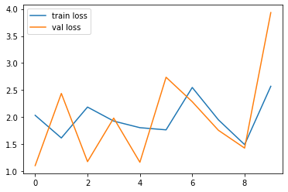
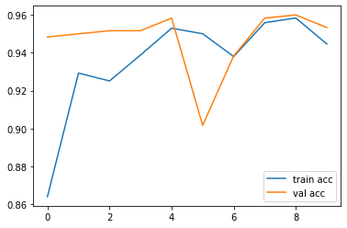
INCEPTIONV3

Slide 8
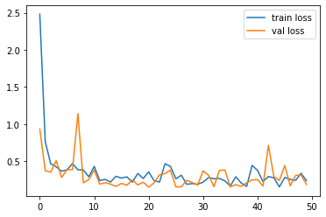
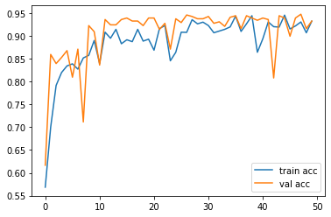
RESNET50

Slide 9
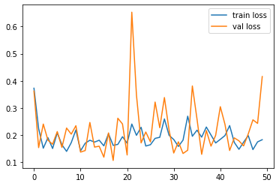
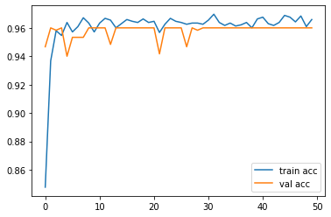
VGG16

Slide 10
The visualizations is about the training and testing accuracy of the each model and the train loss and validation loss of models. Here for this project I have used three models inception v3, resnet 50 and vgg16.

Slide 11
STEPS AND ASSUMPTIONS

Slide 12
We have three categories of images to predict. By detecting the features of images and predict which category the particular image belongs.
As we scrapped the images we can say that the image is in RGB format.
It is because we have colour images
Images are in the three dimensional matrix that is images have height, width in pixels and RGB.
The main step I take for the each models is that specify that don’t train in the existing layers of each models. Because as we all know it is already trained and weights are fixed.

Slide 13
MODEL DASHBOARD
FINALIZED MODEL

Slide 14
For this particular project I have used three different models for the classification of images.
Here I have used INCEPTIONV3, RESNET50, VGG16(VISUAL GEOMETRY GROUP).
The aim of each model is same. But the processing is different that is the time of processing different in different models.
Three models perform very well have training and validation accuracy are almost equal for each models.
But I have chosen VGG16 as my finalize model
Because in each epoch the training and testing accuracy losses for training and validation losses are almost equal for each epochs in VGG16.
So I select VGG16 as my best model.

Slide 15
CONCLUSION

Slide 16
Image classification can be apply in real world.
In India motor vehicle department launches the AI camera for checking the people who are not obeying the laws in the roads.
This camera is works in this type of projects. That is it will detect the images and categorize it into different categories.
that is the camera is able to differenciate the vehicles which are obeying and disobeying the law.

